Slide 1

Rubber & Spice Exchange

Slide 2
Introduction
→
The Rubber & Spice Exchange is an innovative online marketplace for rubber milk, rubber products, spices, and spice powders. It connects buyers and sellers directly, enhancing transaction security and transparency while utilizing a comprehensive role-based access management system.

Slide 3

01
Existing System Issues

Slide 4
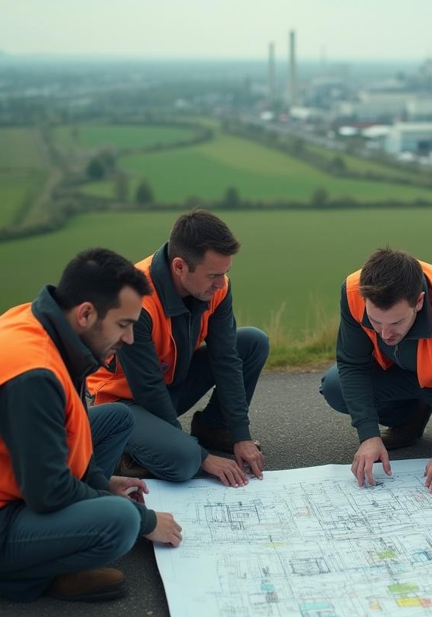
Challenges in Factory Location Discovery
Users face difficulties in effectively locating factories for purchasing rubber and spices. The current system lacks a streamlined way for users to identify available suppliers within their proximity, hampering trade efficiency.
↓

Slide 5
Transaction Processes and Reliability
→
The existing transaction process raises concerns over reliability. Users often encounter delays and complications when making purchases, which diminishes their confidence in the platform. These issues must be addressed to facilitate secure and timely transactions.

Slide 6
User Obstacles in Buying and Selling
→
Users encounter significant hurdles when attempting to buy and sell products on the platform. These challenges include a lack of transparency in product listings, inefficient communication between buyers and sellers, and barriers to accessing reliable product information, which collectively inhibit user engagement and transaction success.

Slide 7

02
Proposed System Overview

Slide 8
Modules: Admin, Staff, User
→
The proposed system features three key modules: Admin, Staff, and User. The Admin module oversees user verification, manages transactions, and provides oversight on product listings. The Staff module acts as a liaison, facilitating communication between Admin and Users. The User module empowers users to register, manage product listings, and engage in transactions effectively.

Slide 9

Technology Stack: Python, Django, SQLite
The platform is built on a robust technology stack that includes Python and Django for both frontend and backend development. SQLite serves as the database solution, enabling efficient data storage and retrieval. This combination ensures a seamless user experience along with scalability and reliability in operations.
↓

Slide 10
Future Enhancements: Payment Module and Factory Connections
→
Future developments include the integration of an advanced payment module that will simplify transactions. Additionally, the platform aims to connect with local factories within a 50km radius of users, enhancing accessibility and promoting local trade, thus streamlining the buying process.

Slide 11
Conclusions
→
The proposed Rubber & Spice Exchange aims to address existing system challenges by enhancing user experience, streamlining transactions, and establishing a reliable trade environment. Through innovative technology and thoughtful design, this platform is poised to transform the way users engage in buying and selling rubber and spice products.

Slide 12

Thank you!
Do you have any questions?
www.yourwebsite.com
↓
CREDITS: This presentation template was created by Slidesgo, and includes icons, infographics & images by Freepik
+00 000 000 000

